Slide 1
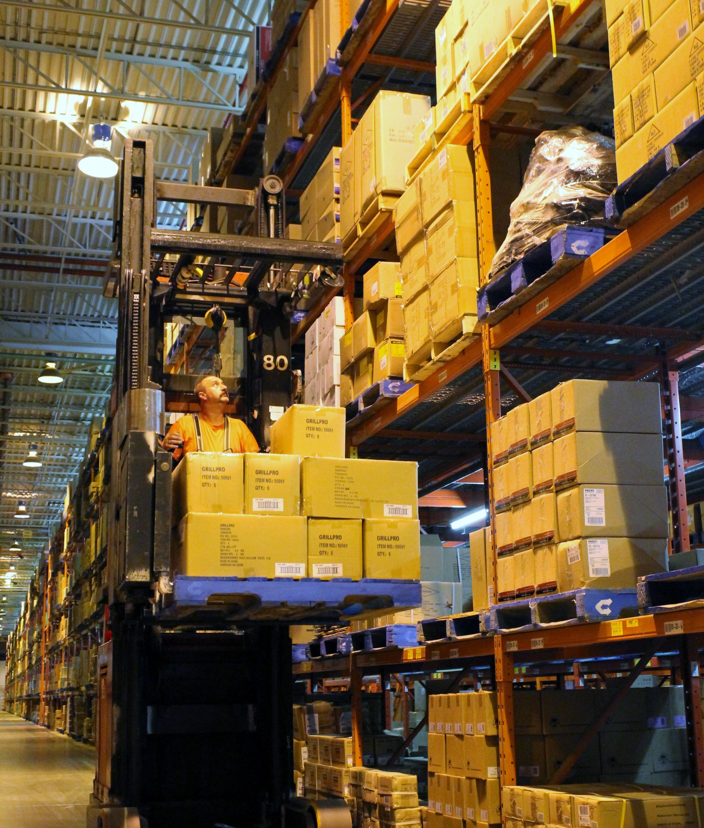

STJ Supervisor
Refresher 2023:
PUTAWAY /
REPLENISHMENT
WM STABILIZATION

Slide 2




Learning Path Overview: Phase II
SOP
Walkthroughs
Tracking Tasks: Area Specific
(Building A, B + West)
Putaway and
Replenishment
Final Assessment
Notes:
TRAINER NOTES:
Now that we are starting Phase 2 of our learning, we want to outline the learning path and provide a little more information as to what you are going to be learning in this class:
Press ENTER – “Putaway and …” text box appears
Putaway and Replenishment:
This course will focus on those two practices
Press ENTER – “SOP Walkthroughs” text box appears
SOP Walkthroughs:
Going through the steps for each function and how they come together
Press ENTER – “Tracking Tasks” text box appears
Tracking Tasks:
We will help you set up the exact Filters parameters for the specific area you work in daily
General lead hands might want to make as many of these as they can OR reuse a public filter someone else has made
Press ENTER – “Final Assessment” text box appears
At the end of this there will be a Final Assessment

Slide 3
Phase II: Lesson Plan Overview
Delivery Methodology:
2 Hour – Instructor-led sessions
PowerPoint Presentation
Handout – In-built Practice Exercises
Formative Exercises
/Assessments:
Individual and group learning exercises
Monitoring Assignments
Group Discussions
Summative Assessment:
Phase 2
– Final Assessment
Notes:
TRAINER NOTES:
Press ENTER – “Delivery Methodology” text box appears
You will participate in a series of instructor-led sessions using Power Point and in-class activities
Press ENTER – “Formative Exercises…” text box appears
Formative Exercises/Assessments:
Formative assessment will measure how your learning is progressing during the sessions.
Formative assessment will happen frequently as I (Trainer) see a need in real-time with planned activities like individual and group learning exercises.
Monitoring assignments will be given to extend learning into the live production environment, either in a way of application or collecting examples or observations to be brought into the next session for relative discussion.
Press ENTER – “Summative Assessment” text appears
Summative Assessment:
Summative assessment is designed to measure “how much” you have learned after completion of each learning phase.
The results will provide me (the trainer) with an overview of what you have learnt throughout a particular unit of study— phase 1, phase 2 and phase 3.
It will help me (the trainer) and my training team determine if you are ready to proceed to the next level meaning have you gained the necessary knowledge and skills to graduate to the next level – phase 2?

Slide 4

MA’s Suite of Products
Founded in 1990, Manhattan is a global corporation, recognized as a world leader in creating supply chain solutions.
Nearly 450 warehouses throughout the world are using Manhattan’s supply-chain technology, including GM, Costco, Walmart, and Home Depot.
WMS
(Includes Dashboards)
SLO
Slotting
Labour Management
SCI
(Cognos)
LMS CA 2015
Notes:
TRAINER NOTES:
We’re going to talk for a minute about some of Manhattan’s technology, Home Hardware uses to keep product moving out of the warehouse.
Press Enter – Bullet Points #1-2 appear
Manhattan produces a large suite of software, just as Microsoft produces Word, Outlook, Excel, etc.
Manhattan is the parent company and the 5 main products that we use at Home Hardware are…
Press Enter – 1st box appears (WMS)
WMS stands for Warehouse Management Systems and includes both interactive UI screens and dashboards for data analysis.
All hardware, which includes the Talkman, MCs, tablets, etc., are connected to WM and interact via 2-way communication
Press Enter – 2nd box appears (SLO)
SLO is used by Inventory Management (formerly called product placement) to slot items in the warehouse.
The Slotting tool optimizes placement of product.
For example, the most frequent picks are slotted in the ‘Golden Zone’ (pick locations that are accessible at waist-level) for efficient and easier physical picking
Press Enter – 3rd box appears (Labour Management)
Labour Management (or LM) is used to analyze and report against staff performance
LM is not yet installed in STJ
Press Enter – 4th box appears (SCI)
SCI stands for Supply Chain Intelligence and is used to pull data from WM and compiles it into a report.
Press Enter – 5th box appears (SCI)
LMS CA 2015 is Manhattan’s transportation system
All Inbound Shipment information from Carriers interface to this platform

Slide 5

Putaway from Receiving
Group (Peer-to-Peer) Discussion:
Receiving SV/LHs to explain Putaway, from a Receiving perspective
Provide information around…
  How putaway allocation works
  Cubing
  Sorting
  Best practices for Receiving SVs to monitor + manage processes that impact Putaway
Notes:
TRAINER NOTES:
Press Enter – Bullet Point #1 appears…
Introduce group activity
Read Bullet Point #1
Press Enter – Bullet Point #2 + sub-bullets appear…
Introduce the topics the Receiving SV/LH(s) will present
Read Bullet Point #2 + sub-bullets

Slide 6


Putaway Overview
Putaway is the process of locating received product into Reserve
There are 3 methods to doing Putaway:
Task List
Enter Task
Manual
PROS & CONS
Notes:
TRAINER NOTES:
Press Enter – Bullet Point #1 appears
Read Bullet Point #1
Press Enter – Bullet Point #2 appears
Read Bullet Point #2
Press Enter – “Tasking” appears
Tasking:
Accessing/executing tasks via Task List
Recommended method, as the tasks are listed in priority order
Press ENTER – “Enter Task” appears
Enter Task:
Specifying a particular Task or iLPN
We will discuss in-depth further into the presentation
Press ENTER – “Manual”
Manual:
There are 2 types of Manual:
#1: User tells the MC an iLPN needs to be put away; WM subsequently tries to find a spot for it
Ask the class, “Can anyone provide an example of this type of manual transaction?”
Answers:
Ptwy iLPN
Ptwy iLPN By Plt
#2: User tells the MC an iLPN needs to be put away and chooses the location to putaway to
Ask the class, “Can anyone identify which transaction does this?”
Answer: Locate iLPN
Press ENTER – “PROS & CONS” appears
PROS & CONS:
Let’s name at least one pro and one con for each of these three methods
Starting with TASKING
PRO: In order of priority
CON: iLPN may be buried behind other pallets
ENTER TASK:
PRO: Allows you to scan an iLPN and the MC immediately finds the task associated to that iLPN
CON: The staff control when product moves and priority
MANUAL:
PRO: More User control for specific situations
CON: Higher risk of causing other issues (E.g.) locating product to an area that isn’t supported from a Task Path perspective

Slide 7

Putaway: WM Guiding Principles
Item + Location + Quantity
By ensuring every physical action is matched with a systemic action (this achieves a higher perfect order rate)
To ensure we efficiently move inventory
between locations
via our processes
Inventory
iLPNs UI
Locations
Reserve Locations UI
Drop Zones
Process
Tasks UI
WG/WA + Saved Filters
Notes:
TRAINER NOTES:
Ask class if they remember from the General Course, what are the 3 components of the 3 C’s
Press Enter – Bullet Point #1 - “Item + Location + Quantity” text box appears…
Answer: Remember the three Cs are
have the CORRECT item…
in the CORRECT location…
with the CORRECT quantity
Ask the class How should you maintain this guiding principle
Answer: By ensuring every physical action is matched with a systemic action
Press Enter – Bullet Point #2 - “By ensuring every…” text box appears…
Read Bullet Point #2 (discuss – if necessary)
Press Enter – Bullet Point #3 – Part #1 appears
Read Bullet Point #3 – Part #1
Reference iLPNs is the UI screen to manage, monitor and troubleshoot this component
Press Enter – Bullet Point #3 – Part #2 appears
Read Bullet Point #3 – Part #2
Reference Reserve Locations is the UI screen to manage, monitor and troubleshoot this component
We have already covered Reserve Locations in Phase I-GENERAL
This week we will further explore how using this screen to manage, monitor and troubleshoot Drop Zones
Press Enter – Bullet Point #3 – Part #3 appears
Read Bullet Point #3 – Part #3
Reference Tasks is the UI screen to manage, monitor and troubleshoot this component
Later this week we will help you create Saved Filters
We understand that some of you may be using Filters, however, some of these have been created at Go-Live, and a lot of changes have happened in the past 2 years

Slide 8


Putaway: Locations
Drop Zone
A Drop Zone is an intermediary location. It is typically required whenever a movement requires 2 types of equipment.
Putaway moves will always have a START location + END location
Monitor Drop Zones
Log into WM PRD
Open Reserve Locations UI
Enter the location BCDZ206-998-01E
Press Apply
Select the box next to the Reserve Location
Select LPNs
Notes:
TRAINER NOTES:
Press ENTER – “Putaway moves will always…” text box appears
Read the Bullet Point
Ask the class, “ As SVs in your designated buildings, where would Putaway start?”
Press ENTER to display a Hint, “Where we droppin..” GIF appears
Answer: Drop Zone
Ask the class, “What is a Drop Zone?”
Press ENTER to display the Answer
Read the Answer
An example requiring a Drop Zone location is a High Reach from Staging to a Drop Zone, and then an SA from the Drop Zone to Reserve
Like any other location in the building, Drop Zones should be monitored as part of a regular ‘Health Check’
For example, if there are physically 10 pallets in the Drop Zone, there should also by 10 systemic LPNs in the location
Press ENTER “Monitor Drop Zones” section appears
Ask the class to log into PRD, and search for BCDZ206-998-01E
Demonstrate/discuss how to look up a Drop Zone (Steps 1-6)

Slide 9
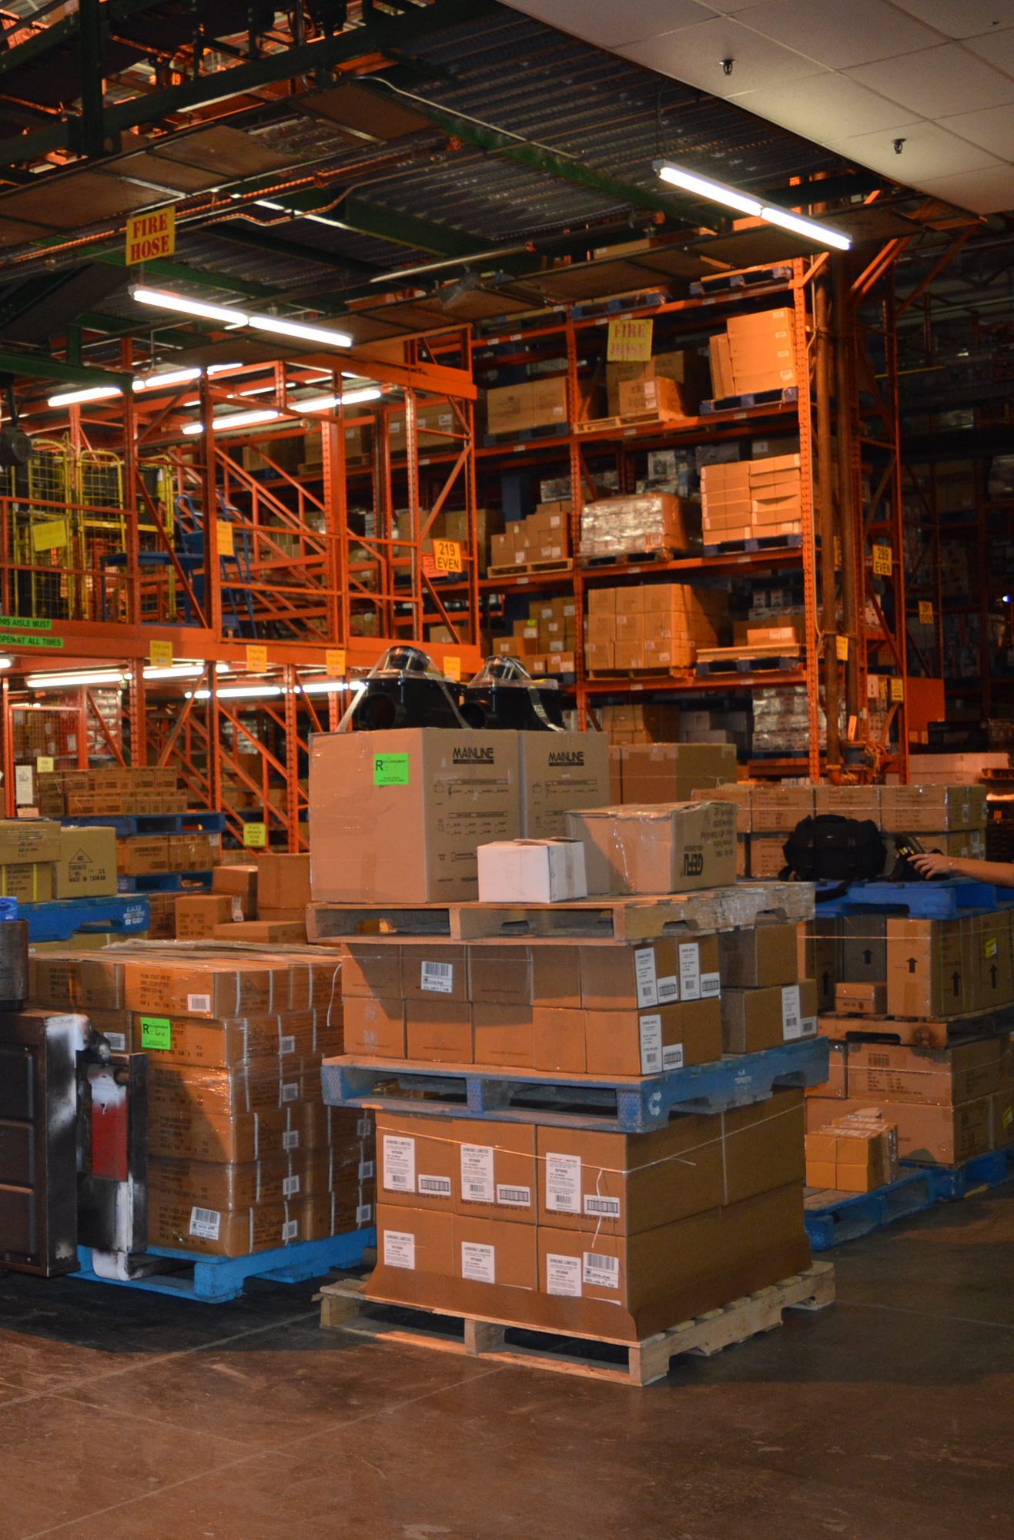
Just like Reserve locations, Drop Zones require regular monitoring…
Putaway: Monitoring Locations
BEST PRACTICES:
Check the Drop Zones regularly
Export/print Drop Zone details to physically check the Drop Zones
The physical should match the system
This is live data and health checks should be done immediately
Pallet LPNs do not go away (Ignore them)
LPNs that are old (week) should be investigated by IM, a Supervisor/LH or designated staff
Notes:
TRAINER NOTES:
Read opening Bullet Point, “Just like Reserve locations…”
We have discussed Reserve locations during Phase I-General, let’s now go over Drop Zones
Press Enter: Bullets 1-5 appear
Read the bullet points
Discuss with the class that there needs to be a mindset change
Points to discuss:
Monitoring the drop zones helps receiving and putaway, improving dock-to-stock
Product is allocable for Dealers as soon as its in a Reserve, so let's get it there faster

Slide 10
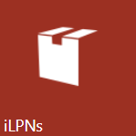
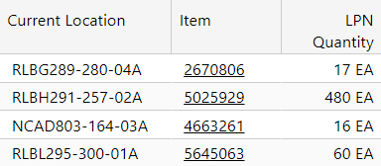
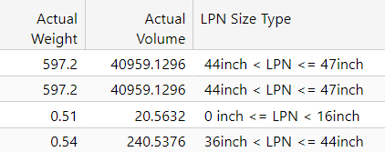

Putaway: iLPNs
Case Locks
What are Case Locks and why
do we need them?
The iLPNs UI screen offers a wealth of data for every iLPN recorded in WM
Case Locks is a method of flagging
iLPN inventory to make them
unallocable in either WM or HH1
Common Attributes
Case Lock Activity:
1. Review Case Lock QRM
Current Location
Item
Quantity
2. How to view Case Locks in the UI
3. How to view Case Locks in the MC
Troubleshooting Attributes
Weight
Volume
LPN Size Type
Notes:
TRAINER NOTES:
We’re going to look at the iLPNs UI screen in WM
Press ENTER – “The iLPNs UI screen offers…” text box appears
Some of the different attributes that can be found on this screen are quite common
Press ENTER – “Common Attributes…” text box appears
Review the Common Attributes columns with the class
Some attributes may subjectively be ‘Common’ to certain groups
In TRN UI, navigate to iLPNs screen > Set ‘From’ and ‘To Status’ to [Putaway] and then press Apply
Ask the class, “What might be a common attribute for a Receiving SV/LH?”
Answer(s):
PO – Which Purchase Order the iLPN was received against
ASN – Which ASN the iLPN was received against
Create Time – Date/Time the iLPN was received
There are other attributes that some supervisors or lead hands may not be aware of
Press ENTER – “Troubleshooting Attributes…” text box appears
Review the ‘UnCommon’ or Troubleshooting Attributes
Ask the class, “Why would Weight and/or Volume be a point-of-interest in Troubleshooting”?
Answer: Scenarios where WM cannot find a Putaway location, even though a physical review of the LPN suggests it can be putaway with no issue
Ask the class, “Does anyone know what LPN Size Type is?”
Answer: “Pre-determined value settings for the type of LPN the item can be placed into; most of our LPN Size Types are variations of pallet sizes”
Instruct the class…
In TRN, click on the “?” icon located at the top right of the screen
In the ‘Search’ field, type [LPN Size Type]
Explain to the class, that WM has a “Help” feature, which can be used to research WM terminology and concepts
This can be useful at times to provide context to a Training document, SOP, and/or other WM-related content
Disclaimer: the information stored in the “Help” feature is out-of-the-box descriptions, and is not tailored to a specific company, like Home Hardware
Click on the ‘LPN Size Type’ hyperlink to display MA’s information
Review at the highest-level
Press ENTER – “Case Locks…” + 1st Bullet Point appears
Ask the class, “What are Case Locks and why do we need them?”
Press ENTER to display the Answer
If there is a concept that we know is HH-specific – for example, Case Locks – relying on SOPs and QRMs is a good way to find out additional information
Navigate to 2019 QRMS > GENERAL > QRM-GN-EQIP-151.Lock-Codes-RECV-IV_STJ v1.0
Review QRM details
Press ENTER to display “Case Lock Activity…”
Provide instructions for the group activity…
Divide the class into 2 groups
Group 1 – Determine how to look up and interpret Case Locks via the UI
Group 2 – Determine how to look up and interpret Case Locks via the MC
Group 2 will need to obtain an MC from the Training Hardware cabinet
Each group will present their findings
Once each group has presented, review key learning points…
What type of case lock?
Is the iLPN located to a legitimate location, where case locks are acceptable? I.e.) There should be no iLPNs in Reserve with a case lock (unless recently locked by Staff – E.g.) During a Putaway exception)
How to look up multiple lock codes

Slide 11
Putaway: Tasks
Picking Supervisor View Putaway Tasks in WM
Steps to View Outstanding Putaway Tasks
Steps to Save Filter
Navigate UI: Tasks
Press [Quick Filter]
From the drop-down list, select [Saved Filter]
Click on the downward arrow to the right of “Apply”
Press Configure
Press Add
Type “Monitor Putaway Tasks” in
‘Filter Name’ and ‘Description’
fields
Set “Inventory Need Type” to “11 Putaway full iLPN”
Set Header Status to include everything from “In drop zone” to “In Progress”
Set “Current Start WG/WA”
Press Save and Apply
Set “Inventory Need Type” to
“11 Putaway full iLPN”
Set Header Status to include everything from “In drop zone” to “In Progress”
Set WG/WA
Click “Apply”
Notes:
TRAINER NOTES:
Like all tasks, putaway tasks are monitored through the Tasks UI screen
Press Enter “Picking Supervisor: View Putaway Tasks in WM” appears
The Picking Supervisor’s job is to see to it that all Putaway tasks are cleared from the drop zones in their respective areas.
Putaway tasks are not complete until they have been located to a reserve location.
Until the iLPN is in a reserve or active location, it cannot be allocated for picking.
Press Enter “Steps 1-4” appear
Instruct the class to log into WM Prod
Press Enter “Steps to View Outstanding…” + Steps 1-4 appears
Demonstrate + instruct the class to follow along and create the saved filter in WM Prod
NOTE: This demo will require a handout with the proper wg/wa for each building.
Press Enter “Steps 1-13” appears
Demonstrate + instruct the class to follow along and create the saved filter in WM Prod
Demonstrate how to retrieve/use the newly saved filter

Slide 12

Putaway: Process Walkthrough
Reserve
Drop Zone
Staging
Receiving
Team Members:
Sign into the MC and the appropriate Task Group
Access Task List (or Enter Task) and then scan the iLPN in the Staging Area
Follow the MC prompts
  Sort pallets are moved by pallet and not by individual iLPNs
Supervisors/Lead Hands:
Monitor your drop zones
Troubleshoot Putaway issues/ exceptions
Notes:
TRAINER NOTES:
Press ENTER “Receiving + Staging” appears
Receiving + Staging:
As discussed, every Task has a ‘start’ and ‘end’
For Putaway Tasks managed by Receiving, the ‘start’ point is the Staging Area
Press ENTER “Drop Zone” appears
Drop Zones:
The Haulers take the product from the Staging Area to an interim location or as most of us know it as, ‘Drop Zones’
Haulers physically place their skids – whether it be Full iLPNs or Sort Pallets in the directed Drop Zone
Ask the class, “what must also occur at this stage?”
Answer: “Systemically scan the Drop Zone location barcode”
Press ENTER “Reserve” appears
Reserve:
The Reserve location is where a Putaway task ends
Press ENTER “Team Members” appears
Team Members:
Read Bullet Point #1
It is crucial that putaway staff sign into the appropriate task group based off their work assignment
Read Bullet Point #2
Task List will show you the highest priority task within the work area tied to that Task Group
Enter Task allows you to select an iLPN for putaway
Ask the class, “What are some reasons why a Putaway Team Member would need to use Enter Task?”
Answer(s):
Priority iLPN is blocked
Need to expedite certain merchandise (E.g., Halloween confectionaries)
Read Bullet Point #3
Press ENTER “Supervisor/Lead Hands” appears
SVs/ LHs:
It is your job to ensure there is a decent flow going on in the DC
This means talking to one another and talking to the haulers
You are also responsible to monitor and assist potential putaway issues

Slide 13

Putaway: Exceptions
Use Enter Task
Reserve location already has
product in it
iLPN does not fit into Reserve location
There is no task
for iLPN
Notes:
TRAINER NOTES:
Ask class to navigate to F:\Special\Distribution WM SOPs on their desktop
Press ENTER – “Enter Task” appears
Ask a volunteer to read SOP Exception “How to obtain a Task via Enter Task”
Discuss details with the class
Press ENTER – “Reserve Location already…” appears
Ask a volunteer to read SOP Exception “Directed Reserve location already contains product”
Discuss details with the class
Press ENTER – “iLPN does not fit into…” appears
Ask a volunteer to read SOP Exception “iLPN does not fit in directed Reserve Location”
Discuss details with the class
Press ENTER – “There is no task for iLPN” appears
Ask a volunteer to read SOP Exception “There is no task for the iLPN (or pallet LPN)”
Ensure the class understands that this is an exception to be performed by SV/LH only
Discuss details with the class

Slide 14
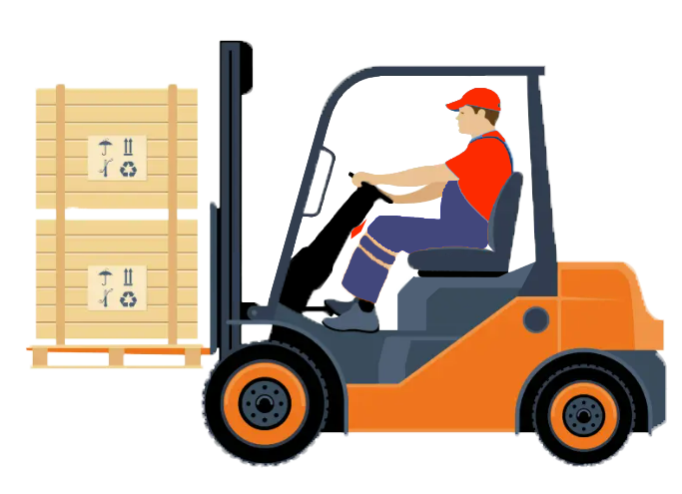


Putaway: Scenarios - Cause & Effect
For each scenario, let’s discuss how Rod’s ACTIONS impacts the next person in the PROCESS
Our Hauler, Rod
SCENARIO #1:
Rod just uses ENTER TASK and takes the EASIEST pallet to grab from Staging.
SCENARIO #2:
Rod’s next task in Task List is a Putaway task. He checks the active location, and makes a judgment call to: (1) Back out leaving the task ‘Partially Assembled’, and instead (2) use Fill Active.
Notes:
TRAINER NOTES:
Press ENTER – “Picture of Rod” appears
This is Rod the Hauler
Let’s explore a couple of scenarios Rod encounters
Press ENTER – “For each scenario…” text box appears
For each Scenario, let’s discuss how Rod’s actions affect the next person in the process, whether that be a replenisher, a picker, a shipper, etc.
Press ENTER – “Scenario 1…” text box appears
Consider this:
The pallet Rod grabs might not be needed at this moment, I.e., there might not be any allocations for that product
Though it gives Staging an empty space, the drop zone Rod is directed could needlessly be physically full
Affects:
Drop Zones might be getting overfilled
Less room for machines to get around in the Building Drop Zones
Priority product sits idly in Staging
Press ENTER – “Scenario #2…”
Consider this:
Rod has left the Task in Partially assembled status, which is technically not complete
Effects:
An associated Replenishment Task will face an ‘overfill’ scenario
If the iLPN had an allocation for a FPP, no task will generate, shorting the Dealer
Though ‘Fill Active’ was done with best intentions, it has needlessly created additional exceptions, workarounds + troubleshooting effort

Slide 15




Replenishment Overview
GAME RULES
Each Shift will be playing against each other to win the most points
Session A + B group points will be added together
For gaming purposes, Days + Elmira are considered 1 Shift
Just like Family Feud…
A board with a category will be displayed with hidden answers
A player who provides a correct answer will win the answer’s associated points
Unlike Family Feud…
Any player can call out the answer
The only correct answer is the NEXT step within the SOP
Each incorrect answer is a 10-point demerit of the total score
A round can only accept 2 incorrect answers, before the answer is revealed
Notes:
TRAINER NOTES:
Distribute the following SOPs:
Replenish from a Reserve Location
Instruct the class to review the SOPs
After 5 minutes, instruct the class to put away the SOPs (turn it over, so they cannot see/read the details)
Press Enter – Family Feud logo appears
Time to play a game, but with some twists
Let’s review the rules of this game
Press Enter – Text box #1 appears
Read Rule #1 and sub-bullet points
Press Enter – Text box #2 + Game board appears
Read Rule #2 and sub-bullet points
This category is for the Find/Create ASN SOP
Press Enter – Text box #3 appears
Read Rule #3 and sub-bullet points

Slide 16


Replenishment: WM Guiding Principles
Remember:
Main Purpose of a warehouse is to move inventory between locations via a process
Replenishment
Inventory
(iLPNs )
Locations
(Reserve Locns +
Pick Locns)
Process
(Tasks)
Move
Between
Using a
Home Hardware Best Practices
Replenishment should be done in priority order → execute in task list order
Complete Lean Time Replenishment tasks during down time
Continuous monitoring of tasks…
  Are high priority tasks being picked up?
  Are there any assigned tasks by the previous shift?
  Are the task paths properly set up?
  Troubleshooting → Compass Tickets
Notes:
TRAINER NOTES:
Does anyone remember what the main purpose of a warehouse is?
Answer: To move inventory between locations via a process
Press ENTER to display the Answer
If we were to apply that logic, as it relates to UI screens…
Press ENTER 2x
…can anyone take a guess, as to what Inventory UI screen applies to Replenishment?
Press ENTER 2x to display the Answer: Inventory (iLPNs)
…and for locations?
Press ENTER 2x to display the Answer: Locations…
…and lastly, for Process?
Press ENTER to display Answer: Process
Let’s talk about some Best Practices:
Press ENTER to display “Best Practices”
WM is set up to follow in order of priority AND change priorities according to order needs
There is no need to print out task lists or need to give any replenishers specific task numbers
When we first went live and were still working out the kinks
We could see what tasks needed to be done but did not know why it wasn’t coming up on our task list, which is why there were times we had to give our replenishers the task number while SV/ LH escalate the issue by putting in a Compass Ticket
Almost all task path issues can be fixed easily now
As leaders, you must monitor your replenishments closely
You can set up or have already set up filters to help narrow down specific areas of the warehouse (i.e. Building A, Non con)
If you see a high priority replenishment task sitting in the queue: INVESTIGATE!
Check to see if there are tasks assigned to someone from another shift
Usually, you can tell by an employee number you don’t recognize
This means they did not back out properly
Once the task is backed in “Released” status it can be picked up
If there are tasks that do not have a proper task path- send that task number in as a Compass ticket and it will most likely be resolved by the next time you come in

Slide 17

Replenishment: Monitoring Tasks
Building Supervisor/LH
View Replen Tasks in WM
Steps to View Replenishment Tasks
Set “Task Type” to “Replen-Entire iLPN” and “Replen-Partial iLPN”
Set Header Status to include everything from “In drop zone”
to “In Progress”
Set WG/WA
Click “Apply”
Notes:
TRAINER NOTES:
Like all tasks, Replenishment tasks are monitored through the Tasks UI screen
Press Enter “Steps to View Replenishment Tasks” appears
The Building Supervisor’s job is to see to it that all Replenishment tasks are completed in priority in their respective areas.
Replenishment tasks must be complete for WM to release the Picking Task for that specific item.
Not until the iLPN is consumed to the Active location, can the required quantity be tasked for Picking.
Displayed are the steps to create a Saved Filter to monitor Replenishment for all areas
Ask the class, “when you need to select more than one value, do you know what hot key to press?”
Answer: CTRL+key
Demonstrate how to create a filter in TRN SaaS, using the steps displayed on the screen

Slide 18
Replenishment: Monitoring Tasks (cont’d)
Steps to Save Filter
Navigate UI: Tasks
Press [Quick Filter]
From the drop-down list, select [Saved Filter]
Click on the downward arrow to the right of “Apply”
Press Configure
Press Add
Type “Monitor Replenishment Tasks” in
‘Filter Name’ and ‘Description’
fields
Set “Task Type” to “Replen-Entire iLPN”, ‘Replen-Partial iLPN”
Set Header Status to include everything from “In drop zone” to “In Progress”
Set “Current Start WG/WA”
Press Save and Apply
Notes:
TRAINER NOTES:
Instruct the class to create the displayed saved filter in WM Prod
NOTE: This demo will require a handout with the proper WG/WA for each building.
Press Enter “Steps 1-11” appears
Demonstrate how to retrieve/use the newly saved filter

Slide 19



Replenishment: Process Walkthrough
What is replenishment? What is its purpose?
How are Putaway and Replenishment related?
1
2
LOGIN to MC
CHANGE TASK GROUP
3
4
EXECUTE REPLEN PULL
EXECUTE REPLEN FILL
Notes:
TRAINER NOTES:
Press ENTER, “What is replenishment…” text box appears
Ask the class: “What is replenishment? Purpose?”
Answer:
The movement of pulling additional stock from a Reserve to an Active location
The purpose of replenishment is to prevent short/zero picks in the Active location
Press ENTER, “How do Putaway…” text box appears
Ask the class, “How are Putaway and Replenishment related?”
Answer:
WM assigns both Putaway and Replenishment tasks (in priority order) within the current Task Group
The efficiency and effectiveness of how Putaway is managed/monitored, directly impacts the success of Replenishment
Ask the class, “Can anyone elaborate on this statement??
Answer:
If you don’t keep up with Putaway, you will not be able to keep up with Replenishment
Let’s explore the major components of Replenishment
Press ENTER, “Login to MC…” text box appears
Ask the class, “After MC login, what does the Replenisher do?”
Press ENTER, “Change Task Group…” text box appears
Repeat pressing ENTER and discussing the major components of Replenishment

Slide 20


Replenishment: Exceptions
When the Happy Path is not so happy…
  Tasked iLPN is missing:
  You go to a Reserve location as prompted by the MC, but the tasked iLPN is missing
  Tasked iLPN is blocked:
  The specific iLPN it is asking for is blocked. We need to find another iLPN with the SAME product with the SAME quantity.
Notes:
TRAINER NOTES:
Press ENTER – “When the Happy Path…” text box appears
Emphasize the following points around Exceptions…
Typically the output of a missed or incorrect step in the previous process
Can also be caused by bad data, e.g.) incorrect item characteristics, such as volume or weight
Often takes longer to complete versus the Happy Path
Press ENTER – “Tasked iLPN is missing” text box appears
Read the scenario
Ask the class, “What should be done in this scenario?”
Answer: Open and display the Replenishment SOP
Ask for a volunteer to read the individual steps
Discuss with the class…
Possible root causes
How to investigate, i.e.) use Activity Tracking to trace the location and/or iLPN’s history
Press ENTER – “Tasked iLPN is blocked” text box appears
Read the scenario
Ask the class, “What should be done in this scenario?”
Answer: Defer to the displayed Replenishment SOP
Ask for a volunteer to read the individual steps
Discuss with the class…
Possible root causes
How to investigate, i.e.) use Activity Tracking to trace the location and/or iLPN’s history

Slide 21

Lean Time Replenishment:
WM Guiding Principles
Lean Time Replenishment
Lean Time Replenishment allows you to use manual method of triggering replenishment tasks to replenish active or case pick locations using inventory from the reserve location. It provides the ability to generate replenishment tasks outside of the streaming task generation process. This type of replenishment is typically done during times of low shipping volume. Lean time replenishment occurs before streaming, or after streaming, when all picking processes associated with it are finished.
This is a way of filling up all pick locations and getting the locations ready for subsequent picking.
The replenishments can be triggered by either of the following ways:
By defining a range of locations
By defining a range of items
By defining Lean Time Replenishment Rules. The rules are defined separately via the Lean Time. Replenishment Rules transaction which can be linked to the Lean Time Replenishment process transaction.
*Adapted from Manhattan AIM, WMS 2019
Notes:
TRAINER NOTES:
Notes: Just emphasize the purpose of lean time, and when it should happen
Let’s talk about Lean Time Replenishment and its guiding principles.
Press ENTER to display “Lean Time Replenishment”
Read the Lean Time Replenishment paragraph
Press ENTER to display the three replenishment triggers
WM is set up to follow in order of priority AND change priorities according to order needs
There is no need to print out task lists or need to give any replenishers specific task numbers
As leaders, you must monitor your replenishments closely
You can set up or have already set up filters to help narrow down specific areas of the warehouse (i.e. Building A, Non con)
If you see a high priority replenishment task sitting in the queue: INVESTIGATE!

Slide 22
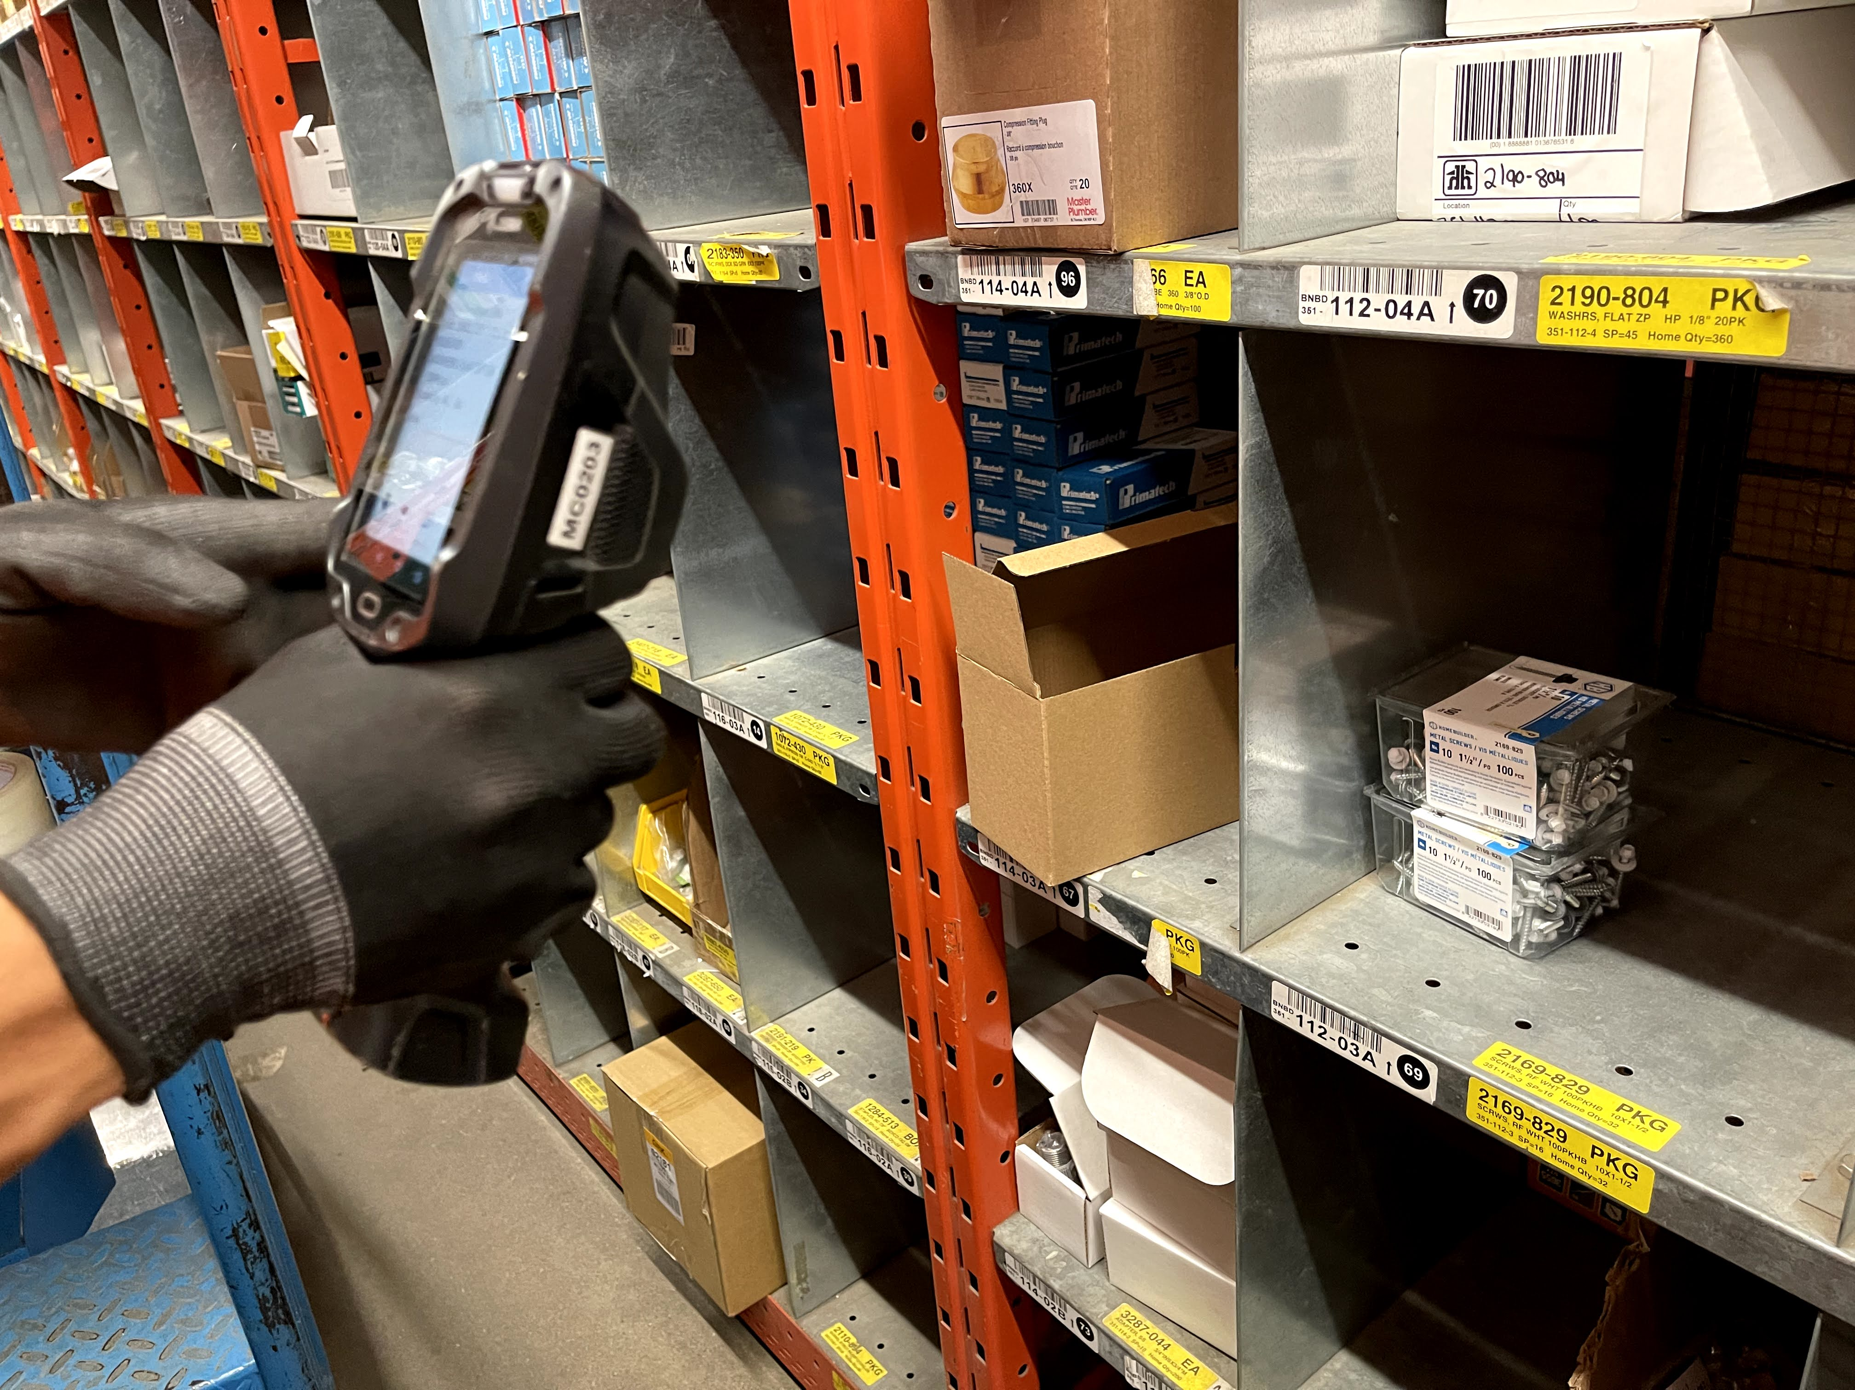
Lean Time Replenishment: DMS
Lean Time for DMS
500 lean time replenishments must be completed each day to maintain proper inventory levels
These must be completed before orders drop
If not completed, these items will be shorted
    This information was obtained from the WMS Stabilization project as we learned from evaluating the entire process.
Need to emphasize the importance of this work, and working together to get these completed.
Notes:
Trainer Notes:
Read the numbered points
DMS lean time is run by DMS supervisors only!

Slide 23



Putaway and Replenishment Conclusion
Staging
Putaway
Reserve
Replen.
Active
Drop Zone
Inbound
P&R
Outbound
Notes:
TRAINER NOTES:
Here we can see the end-to-end process for Putaway + Replenishment.
Press ENTER 3x to illustrate the start-to-end process
Ask the class, “Why is Putaway & Replenishment so important?”
Press ENTER to display HINT graphic
Answer: As Putaway and Replenishment are the link between Inbound and Outbound, it becomes even more crucial to monitor these processes closely
Press ENTER to display “Heart Monitor” graphic
When putaway and replenishment work together properly, we can achieve the perfect order more frequently
As lead hands and supervisors it is your job to monitor drop zones, troubleshoot issues, and ensure priority tasks are completed efficiently (and in order)
Before we move onto the Final Assessment, we are going to perform one more assignment…
This assignment is not only a group assignment, but one that will be conducted across all shifts
Basically, we want you to spend 15 minutes to come up with (1) best practices, (2) opportunities for improvement and (3) shift-end goals regarding Putaway & Replenishment
We (the Trainers) will collect this information and consolidate all Shift input into a single slide and then share it with you all at the end of this Training journey
That way, all the shifts can see what the other shifts are doing, and we are communicating & coordinating as a whole unit

