Slide 1



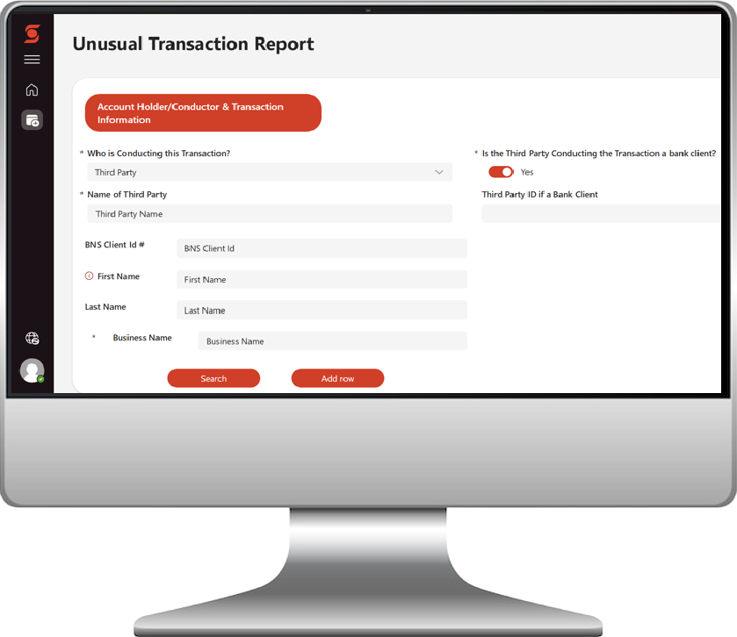

Unusual Transaction Report (UTR)
To strengthen Scotiabank’s Anti-Money Laundering program and support our strategy of making the bank resilient, safe, and secure, a new UTR Form will be launched on September 26, 2025.
New UTR Form Launches in 2025
A simplified 1-page form shortens the submission process and eliminates issues caused by unsubmitted UTRs.
UTR Form Access Link
If you already use the UTR form, you will find it where you do today. For some groups, such as Wealth, there will be a new link on IntraLink, WealthNet or other locations that are easy to find.
Why it Matters
By optimizing the process, we reinforce our commitment to keeping the bank and our clients safe by making it easier for each person to play their role in managing AML risks.
The Benefits
An easier submission with the form length moving from five pages to one page.
An efficient experience with auto-populated fields and drop-down menus.
An effective form as mandatory fields and the option to add attachments as supporting documentation ensures completeness of the form on the first try.
Highlights of Changes
Mandatory auto-populated fields, drop-down menus, and radio buttons ensure nothing is missed.
The option to choose language preference ENG/FR enables users to avoid accessing two separate UTR Forms.
The ability to add attachments supports documentation.
The ability to add up to 10 Client IDs allows bulk case submissions and reduces the need for several manual case creations.
The removal of the ability to save drafts eliminates issues caused by unsubmitted UTRs.
Data transfer to Enterprise Case Management (ECM) system allows investigators to have all the relevant information for reviews without leaving the ECM.
September 2025

